Slide 1


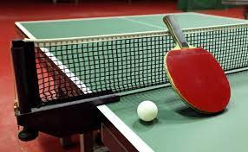
Ping Pong game using Python programming
CSA0810 Python Programming
Project by,
M. Manikanda prabhu,
(192224230)
AI&DS,
SSE, SIMATS.
Guided by,
T. Vincent Gnanaraj,
(Course Faculty)
Python Programming,
SSE, SIMATS.

Slide 2
Introduction
Introductory programming, creating interactive and engaging games serves as an excellent way to hone one's coding skills.
Python, a versatile and beginner-friendly programming language, provides a fantastic platform for game development.
This project introduces a simple two-player game implemented using Python ping pong graphics module.
The game employs basic principles of animation, user input, and collision detection, offering an accessible entry point for those seeking hands-on experience in game development.
Keywords : Url, python,game,paddles,balls
the Turtle graphics library to implement a basic Pong game. Pong is a classic

Slide 3
Abstract
This project presents a straightforward implementation of a two-player game using Python graphics.The game is designed for simplicity, making it an ideal starting point for beginners in programming and game development.The graphical nature of the balls allows for easy visualization of game elements, fostering an intuitive understanding of coding concepts.The game features two paddles, each controlled by a separate player, and barriers bounces between them.The game utilizes fundamental programming constructs such as loops, conditional statements, and user input handling.

Slide 4
Hardware and software requirements
Hardware: Processor: 11th gen intel(R) core(TM) i5-11400F @2.60GHz 2.59GHz.
System type: 64-based processor.
RAM:16.0GB (15.9 GB usable).
GPU:NVIDIA Geforce GT 1030.
Software:
Python: Python is the primary programming language for developing the game. Ensure that Python is installed on your system. You can download it from the official Python website.

Slide 5
Existing system
The existing ping pong game system is a simple graphical program implemented in Python using the Turtle module.
The game provides a basic interactive experience where a ball and paddles moves around the screen based on user input.
The graphical environment is set up using the paddle module, creating a window with a white background.
The player turtle is initialized with a starting position and a moderate movement speed. The game responds to keyboard inputs, allowing the player to control the turtle's movement.
The "Up" key moves the paddle forward, the "Down" key moves it backward, the "w" key , and the "s" key for another palyer
These keyboard bindings enable users to navigate the turtle across the screen and explore the graphical environment.

Slide 6
Proposed System
The proposed system envisions a straightforward two-player game implemented in Python using the graphics module.
The game initializes a graphical screen where two paddles objects represent the players
These paddles take turns moving forward in response to player input, controlled through keyboard commands.
The game loop ensures a turn-based movement system, with boundary checking to determine when a player reaches a specific point, signaling the end of the game.
Upon game completion, the winner is declared, and players have the option to restart. The code is designed with modularity in mind, incorporating functions for screen setup, player initialization, movement, and game over conditions.

Slide 7
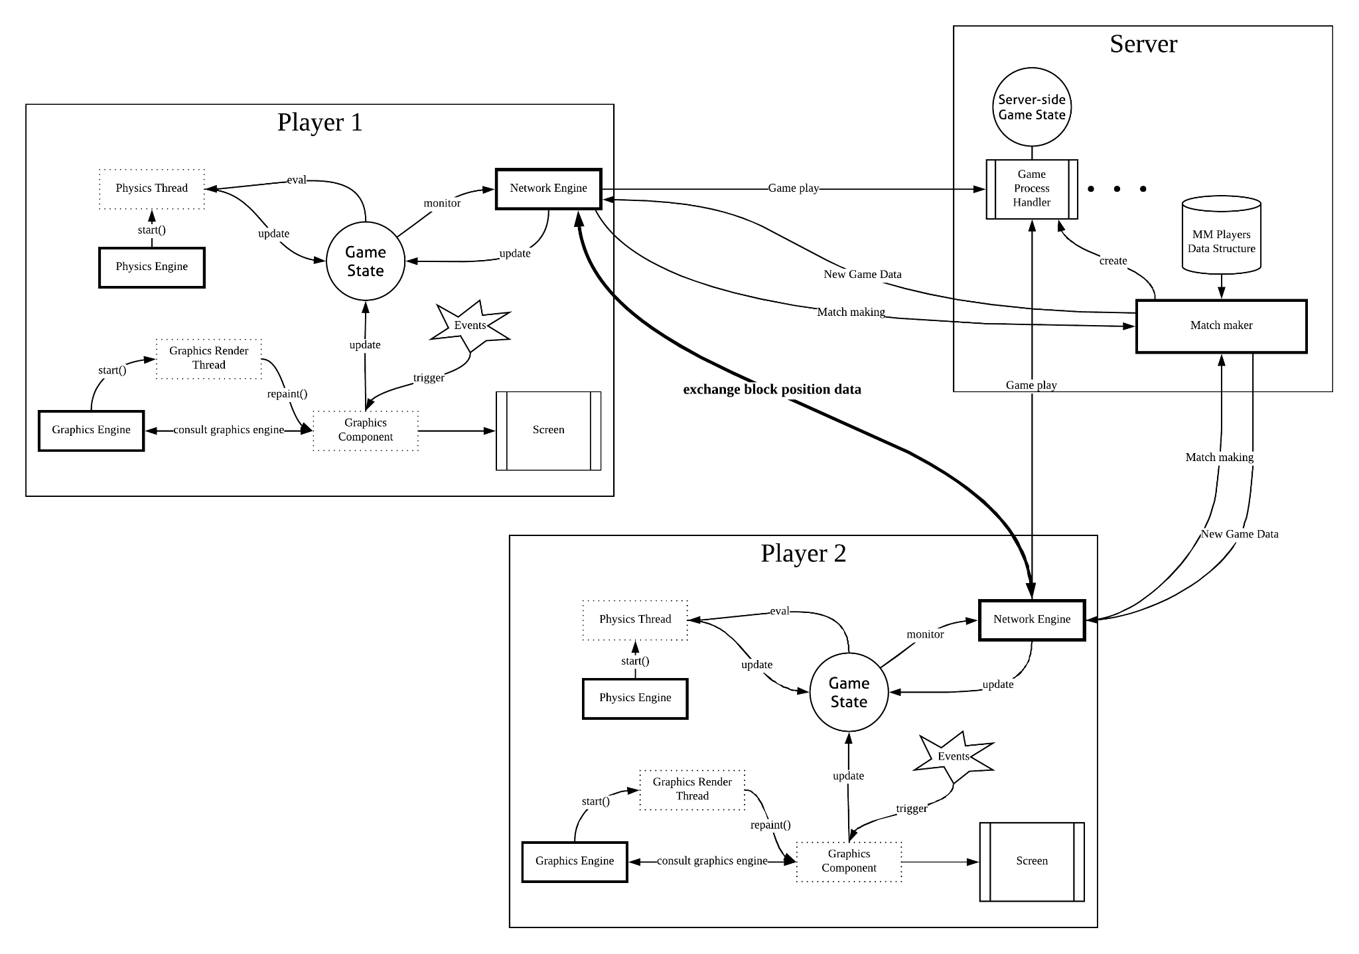
Architecture

Slide 8
Design
The design system for the simple two-player game in Python using the graphics module follows a modular and intuitive structure.
The game's core components include the initialization of the graphical screen and the creation of paddles objects representing each player.
The game loop ensures turn-based movement with responsive keyboard controls.
The system features clear player input handling, boundary checking for game termination, and a concise display of game information.
The modular design promotes code organization, with separate functions for screen setup, player initialization, movement, and game over conditions

Slide 9
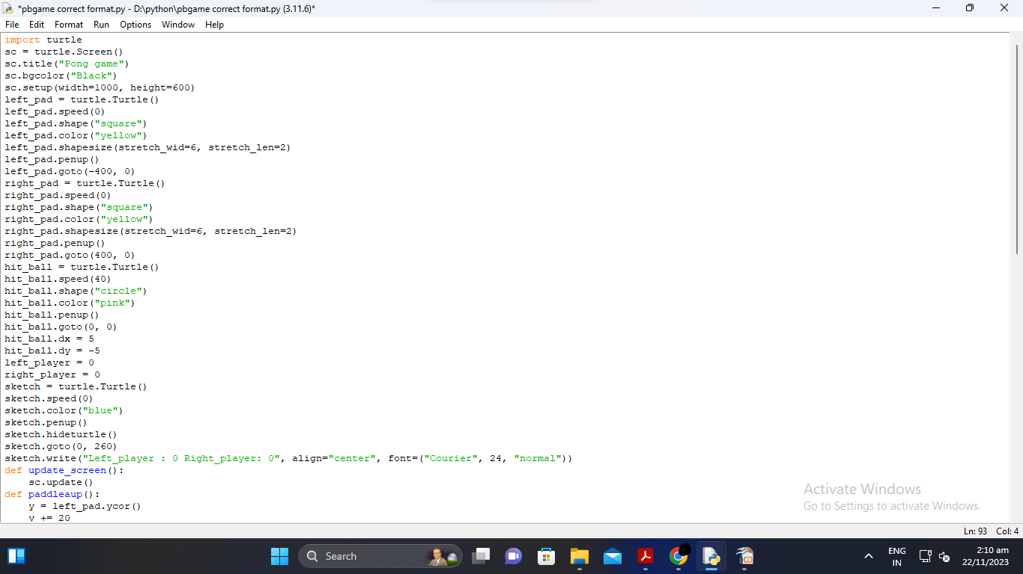
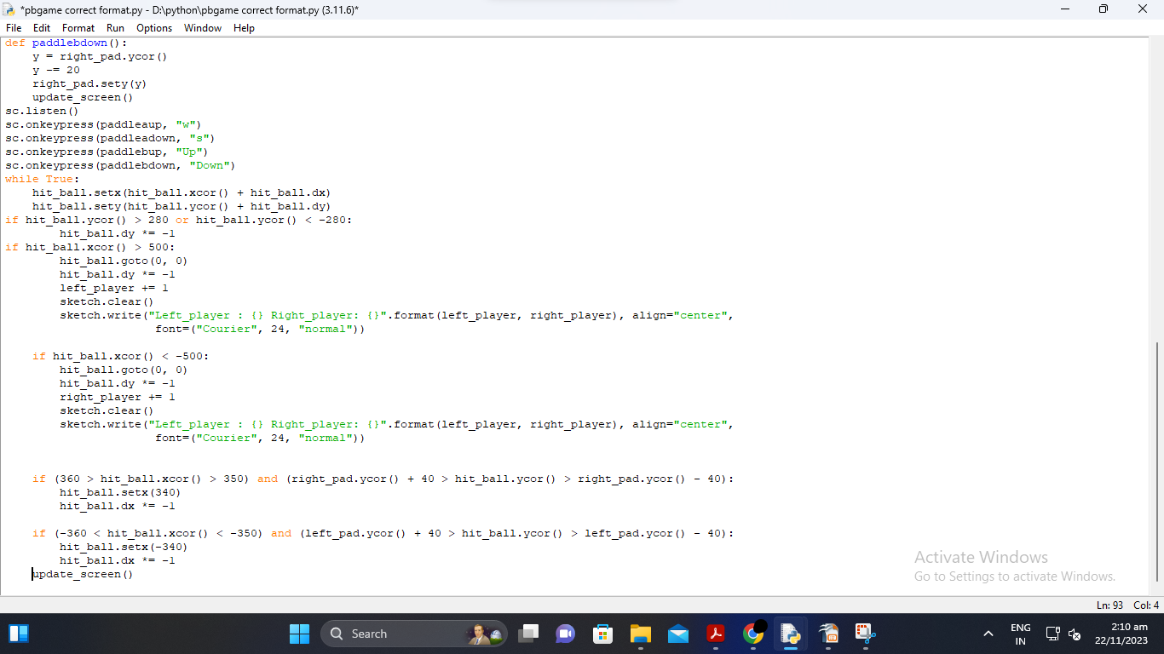
Code

Slide 10
Testing
The testing system for the simple two-player game in Python using graphics involves a series of systematic checks to ensure the game's functionality and user experience.
Initial tests verify that the graphical screen initializes correctly, confirming the display and background settings.
Subsequent tests focus on the accurate creation and positioning of player paddles. Keyboard input testing ensures responsive control for each player, validating the turn-based movement mechanism.
Boundary checking tests ascertain that the game correctly recognizes when a player reaches the designated point, triggering the end-game conditions.

Slide 11
Implementation
The implementation system for the simple two-player game using Python graphics involves writing code to realize the proposed design.
It begins with importing the paddle module and creating functions for screen setup, player initialization, turn-based movement, and game over conditions.
The main game loop orchestrates player turns, capturing keyboard input for paddle movements. Boundary checks are implemented to determine if a player has reached a specified point, signaling the end of the game.
The code is structured with modularity in mind, allowing for easy maintenance and expansion.
Through this implementation system, the interactive and graphical nature of the two-player game comes to life, offering an engaging and enjoyable experience for players exploring Python and paddle graphics.

Slide 12
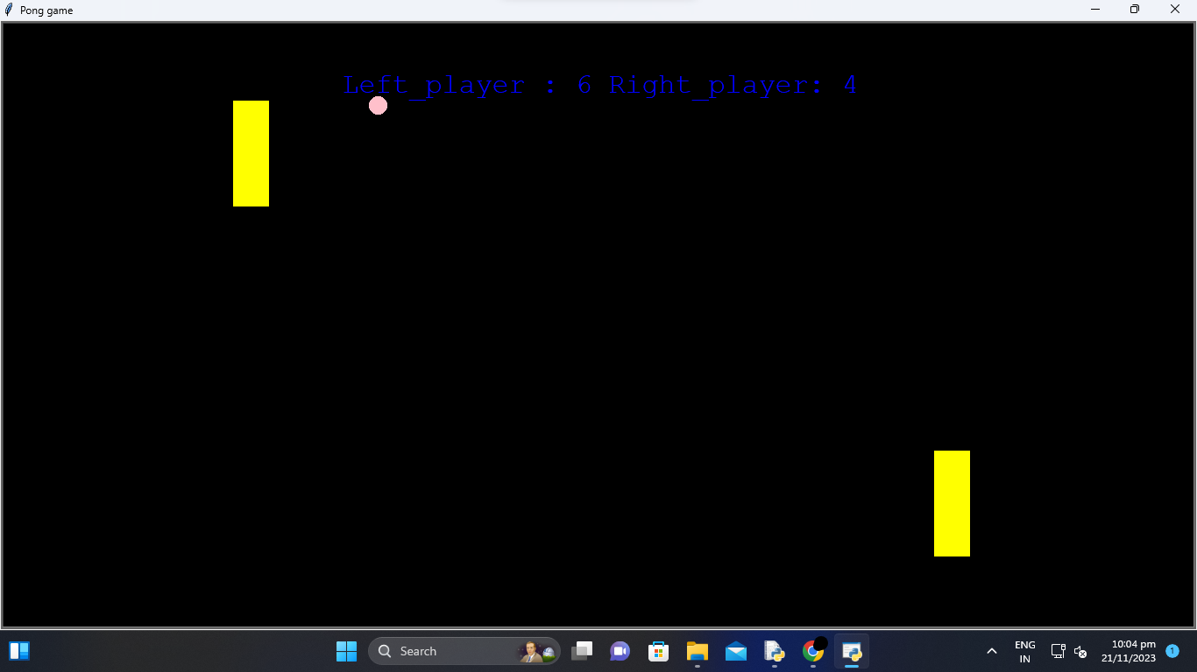
Final output

Slide 13
Future scope
The game can be further developed by adding new features such as multiplayer mode, increasing the number of levels and difficulty levels, and adding more sound effects to provide a more immersive gaming experience.

Slide 14
Conclusion
The Ping Pong game is a fun and challenging project that provides an excellent opportunity for beginners to develop their Python programming skills. We hope this guide has been helpful in taking you through the different stages involved in the project. And these are the methods i used to develop this ping pong game using python codes.

Slide 15
References
Parker, James R. Game Development Using Python. Mercury Learning and Information, 2021.https://books.google.com/books?hl=en&lr=&id=apMUEAAAQBAJ&oi=fnd&pg=PT14&dq=ping+pong+game+using+python&ots=bnJzclY4QU&sig=5S4VqZXHdboZrf3MqCAfeA3Shvc
Ravishankar, Adhithya. "The Ping-Pong Project." (2017).https://egrove.olemiss.edu/hon_thesis/11/
Singh, Aditya, and Vishal Gupta. "Pong Game Optimization Using Policy Gradient Algorithm." International Conference on Next Generation Computing Technologies. Singapore: Springer Singapore, 2017. https://link.springer.com/chapter/10.1007/978-981-10-8657-1_40
Zhang, H., Fu, Z., & Shu, K. I. (2019). Recognizing ping-pong motions using inertial data based on machine learning classification algorithms. IEEE Access, 7, 167055-167064. https://link.springer.com/chapter/10.1007/978-981-10-8657-1_40

Slide 16


